Slide 1
Machine Learning DASC 522
Unsupervised Learning
Dr. Torrey Wagner

Slide 2
Overview
Big Picture
Clustering
K-means
Hierarchical
Dimension Reduction
Principal Components Analysis (PCA) Process
PCA Evaluation
Anomaly Detection

Slide 3
Overview
Big Picture
Clustering
K-means
Hierarchical
Dimension Reduction
Principal Components Analysis (PCA) Process
PCA Evaluation
Anomaly Detection

Slide 4
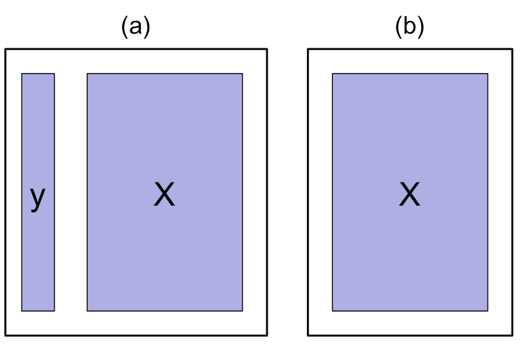
Supervised vs. Unsupervised Learning
Supervised Learning: both X and Y are known
Unsupervised Learning: only X
Supervised Learning
Unsupervised Learning
Slide from Dr. Brett Borghetti, AFIT/ENG CSCE 623 Statistical Machine Learning course, 2019SP

Slide 5
Intro to unsupervised learning
If you don’t have a response variable, you can’t make a function f of inputs to outputs
Is there anything you can do with a bunch observations of predictors?
Slide from Dr. Brett Borghetti, AFIT/ENG CSCE 623 Statistical Machine Learning course, 2019SP

Slide 6
Unsupervised Learning
Even without a response variable, you can still look at relationships within the observations
There are a few things you can do without a response variable - including:
Lump similar observations together: Clustering
Compress data by substituting cluster centers and distributions for observations: Clustering / Mixture models
Interpret & visualize relationships among observations through linear algebraic manipulations (rotations of the feature axes): PCA
Compress data through dimensionality reduction: PCA
Slide from Dr. Brett Borghetti, AFIT/ENG CSCE 623 Statistical Machine Learning course, 2019SP

Slide 7
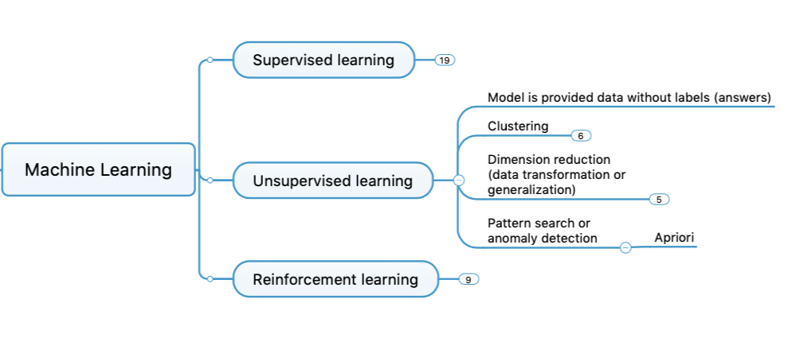
Concept Map

Slide 8
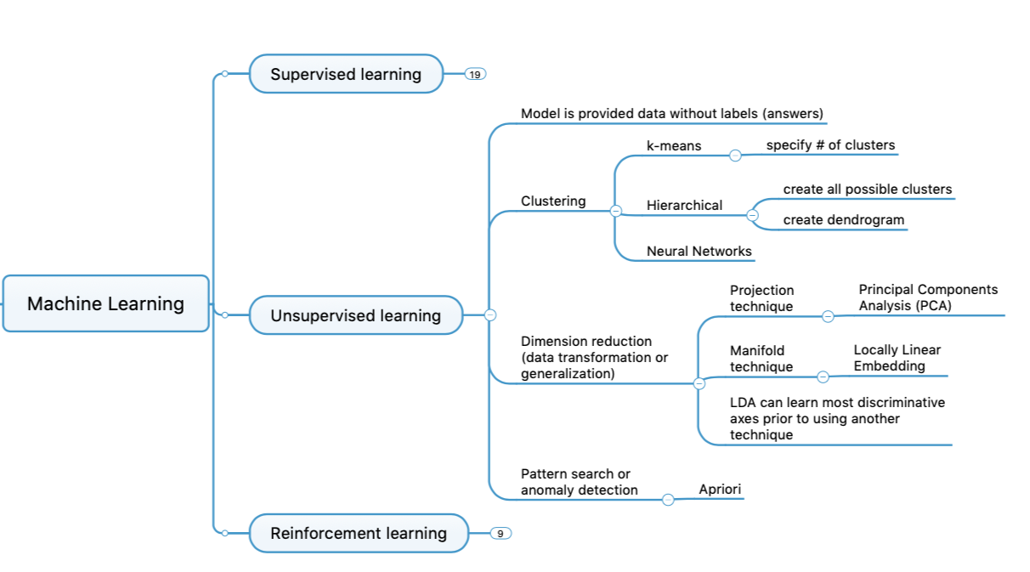
Concept Map

Slide 9
Scikit-Learn API
Click on each to see documentation
https://scikit-learn.org/stable/tutorial/machine_learning_map/index.html

Slide 10
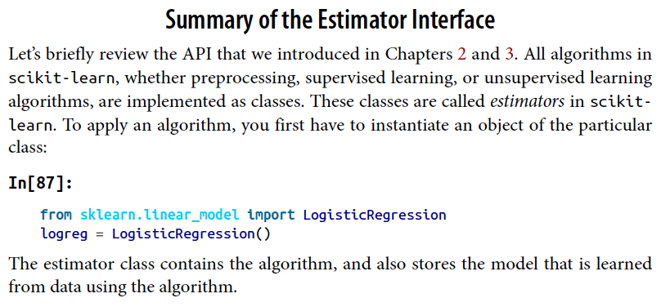
Scikit-Learn API
Muller, Introduction to Machine Learning with Python

Slide 11
Scikit-Learn API
https://towardsdatascience.com/scikit-learn-design-principles-d1371958059b

Slide 12
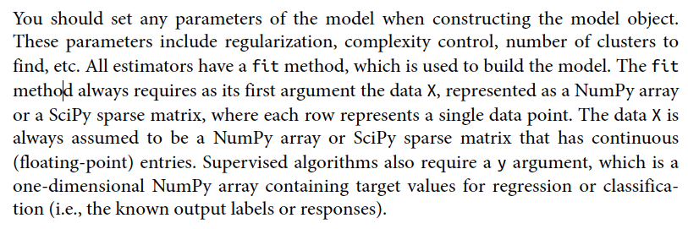
Scikit-Learn API
Muller, Introduction to Machine Learning with Python

Slide 13
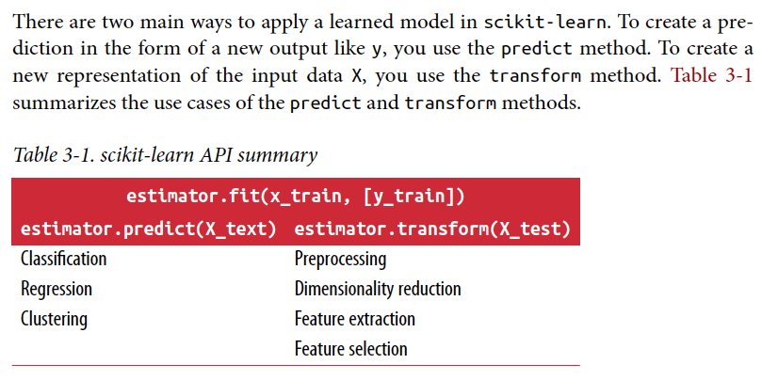
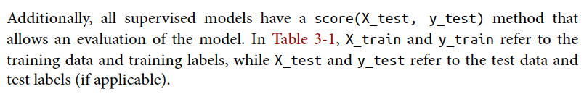
Scikit-Learn API
Muller, Introduction to Machine Learning with Python

Slide 14
Overview
Big Picture
Clustering
K-means
Hierarchical
Dimension Reduction
Principal Components Analysis (PCA) Process
PCA Evaluation
Anomaly Detection

Slide 15
Clustering
Clustering refers to a set of techniques for finding subgroups, or clusters, in a data set
Good clustering: when the observations within a group are similar but observations in different groups are very different
For example, suppose we collect p measurements on each of n pancreatic cancer patients. There may be different unknown types of cancer which we could discover by clustering the data
Slide from Dr. Brett Borghetti, AFIT/ENG CSCE 623 Statistical Machine Learning course, 2019SP

Slide 16
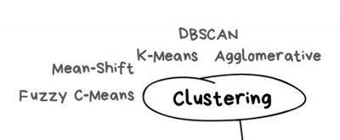
Different Clustering Methods
There are many different types of clustering methods
We will concentrate on two of the most commonly used approaches
K-Means Clustering
Hierarchical Clustering
The objective is to have a
minimal intra-cluster - “within-cluster-variation”, i.e. the elements within a cluster should be as similar as possible
maximum inter-cluster – “center-to-center” distance, i.e. the cluster centers should be as far apart as possible
Slide from Dr. Brett Borghetti, AFIT/ENG CSCE 623 Statistical Machine Learning course, 2019SP

Slide 17
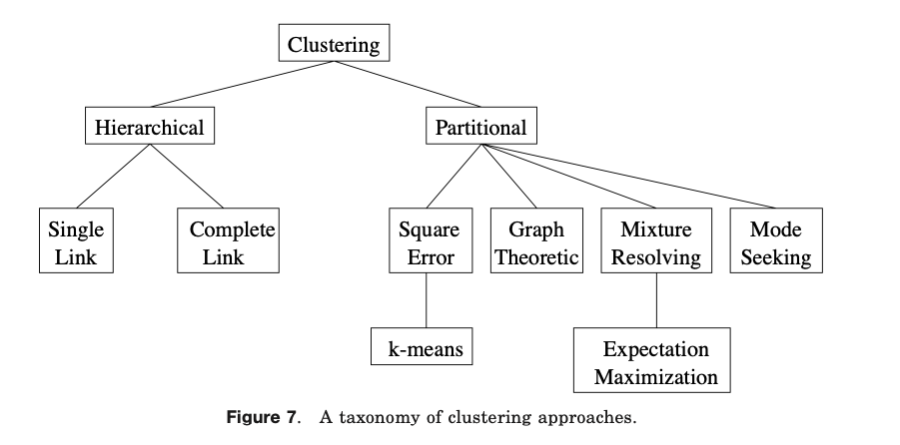
Clustering Taxonomy
Hierarchical clustering algorithms produce a nested series of partitions based on a criterion for merging or splitting clusters based on similarity.
Partitional clustering algorithms identify the partition that optimizes (usually locally) a clustering criterion.
Jain, Murty & Flynn, Data Clustering: A Review, ACM Computing Surveys, Vol. 31, No. 3, September 1999

Slide 18
Clustering Applications
Data understanding
Customer segmentation
Search engine
Image pre-processing
Anomaly detection – cancer genes or test
Dimension reduction

Slide 19
Vocab
Cluster cardinality
the number of examples per cluster. Plot the cluster cardinality for all clusters and investigate clusters that are major outliers.
Cluster magnitude
is the sum of distances from all examples to the centroid of the cluster. Similar to cardinality, check how the magnitude varies across the clusters, and investigate anomalies.
Magnitude vs. Cardinality
create a scatterplot and investigate anomalies. Notice that a higher cluster cardinality tends to result in a higher cluster magnitude, which intuitively makes sense.
Google Machine Learning – Clustering course

Slide 20
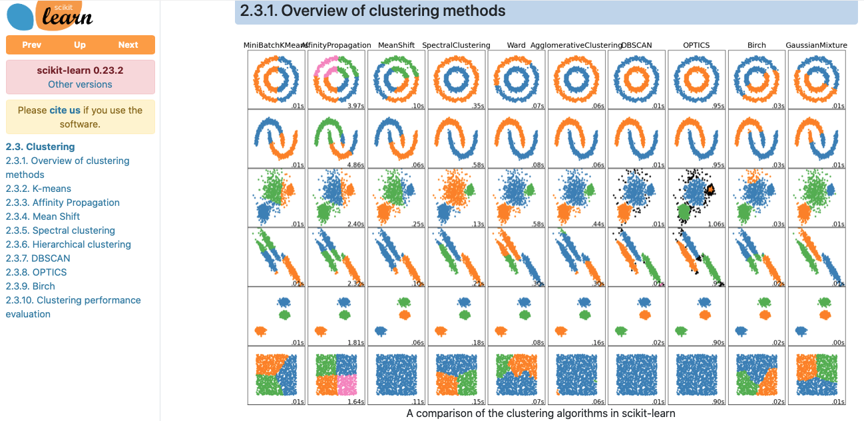
Types of Clustering
https://scikit-learn.org/stable/modules/clustering.html

Slide 21
Overview
Big Picture
Clustering
K-means
Hierarchical
Dimension Reduction
Principal Components Analysis (PCA) Process
PCA Evaluation
Anomaly Detection

Slide 22
K-Means Clustering Overview
To perform K-means clustering, one must first specify the desired number of clusters K
Then the K-means algorithm will assign each observation to exactly one of the K clusters
Slide from Dr. Brett Borghetti, AFIT/ENG CSCE 623 Statistical Machine Learning course, 2019SP

Slide 23
K-means Steps - Summary
You specify the number of clusters (k) to be created and a threshold (i) # of iterations
Then, the K-means algorithm will:
Select randomly k objects from the data set as the initial cluster centers or means
Assigns each observation to their closest centroid, based on the Euclidean distance between the object and the centroid
For each of the k clusters update the cluster centroid by
Calculating the new mean values of all the data points in the cluster.
The centroid of a kth cluster is a vector of length p containing the means of all variables for the observations in the kth cluster; p is the number of variables.
Iterate steps 2 & 3 until the cluster assignments stop changing or the maximum number of iterations i is reached
DASC 500 Week 8 lecture

Slide 24
K-means Visualization 1
Random Assignment of points
Compute cluster centers from initial assignments
Compute new cluster centers
Assign points to closest cluster center
Now there is no further change so stop
Slide from Dr. Brett Borghetti, AFIT/ENG CSCE 623 Statistical Machine Learning course, 2019SP

Slide 25
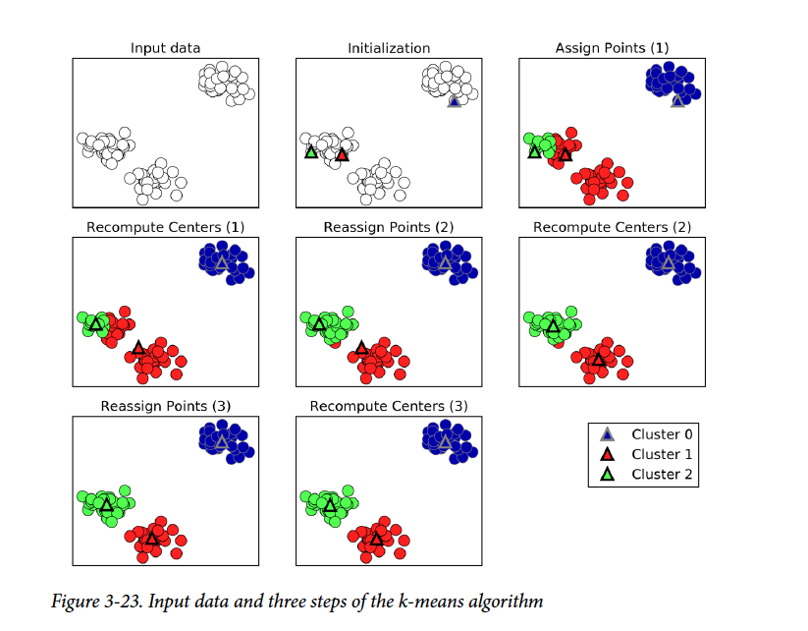
K-means Visualization 2
Muller, Introduction to Machine Learning with Python

Slide 26
K-Means Considerations: K
K-Means Achieves the property:
In K-means clustering, we must specify K for the number of clusters we desire
If we know how many clusters we want, then we can select K
What if we don’t know? How do we determine a “best” K?
Elbow method – compute SSE for several K values and look for the “elbow”:
Other Potential (Automatic) Solutions:
χ-Means (Bayesian Information Criteria)
G-Means (Anderson-Darling)
PG-Means (Kolmogorov-Smirnov test)
“elbow”
SSE
K value
Slide from Dr. Brett Borghetti, AFIT/ENG CSCE 623 Statistical Machine Learning course, 2019SP

Slide 27
K-means Python Demo
Building on the DASC 500 week 8 demo
DASC 500 Week 8 lecture

Slide 28
K-means Pro & Con
Advantages of k-means
Relatively simple to implement.
Scales to large data sets (within reason)
Guarantees convergence.
Can warm-start the positions of centroids.
Easily adapts to new examples.
Generalizes to clusters of different shapes and sizes, such as elliptical clusters.
Google Machine Learning – Clustering course

Slide 29
K-means Pro & Con
Disadvantages of k-means
Choosing manually.
Use the “Loss vs. Clusters” plot to find the optimal (k), as discussed in Interpret Results.
Being dependent on initial values.
Clustering data of varying sizes and density. k-means has trouble clustering data where clusters are of varying sizes and density. To cluster such data, you need to generalize k-means as described in the Advantages section.
Clustering outliers. Centroids can be dragged by outliers, or outliers might get their own cluster instead of being ignored. Consider removing or clipping outliers before clustering.
Scaling with number of dimensions. As the number of dimensions increases, a distance-based similarity measure converges to a constant value between any given examples. Reduce dimensionality either by using PCA on the feature data, or by using “spectral clustering” to modify the clustering algorithm.
Google Machine Learning – Clustering course

Slide 30
K-Means Considerations: Local Optimums
Bad Solution
Good Solution
The K-means algorithm can get stuck in “local optimums” and not find the best solution
Hence, it is important to run the algorithm multiple times with random starting points to find a good solution
Slide from Dr. Brett Borghetti, AFIT/ENG CSCE 623 Statistical Machine Learning course, 2019SP

Slide 31
Other K-Means Considerations
Identification of potential cluster shape – non-convex shapes will perform poorly
Alternatives: CRYSTAL, DBSCAN,…

Slide 32
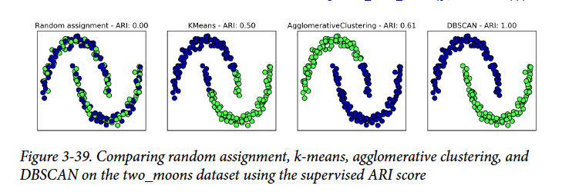
Clustering Algorithm Comparison
Muller, Introduction to Machine Learning with Python

Slide 33
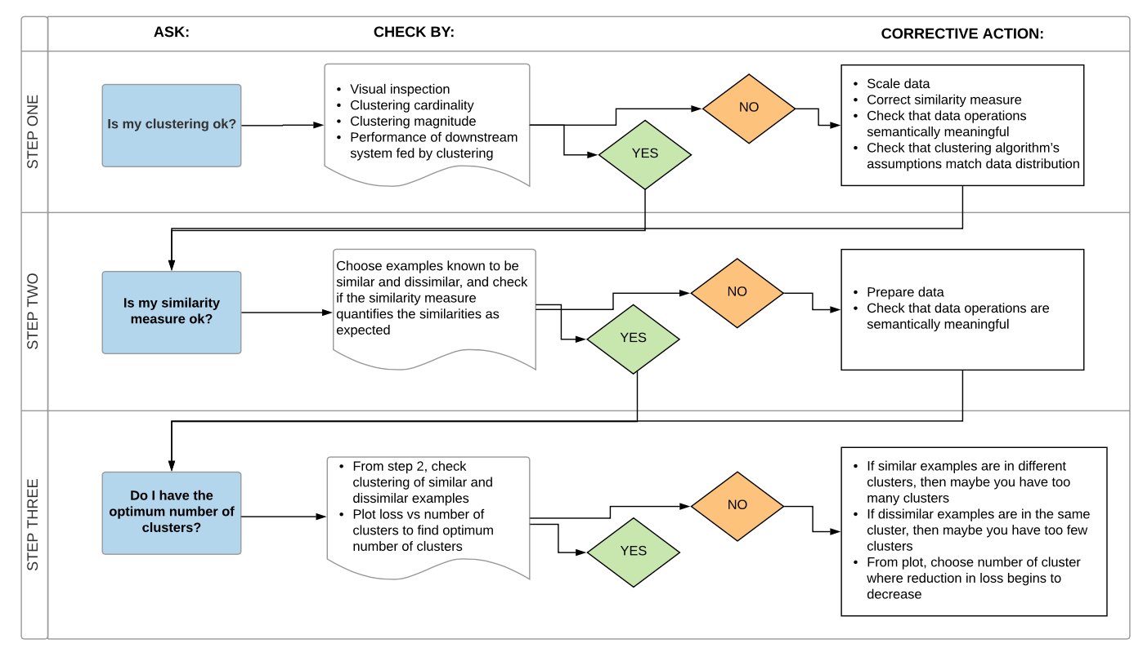
Clustering Flowchart
Google Machine Learning – Clustering course

Slide 34
Overview
Big Picture
Clustering
K-means
Hierarchical
Dimension Reduction
Principal Components Analysis (PCA) Process
PCA Evaluation
Anomaly Detection

Slide 35
Hierarchical Clustering
K-Means clustering requires choosing the number of clusters.
If we don’t want to do that, an alternative is to use Hierarchical Clustering
Hierarchical Clustering has an added advantage that it produces a tree based representation of the observations, called a Dendogram
Slide from Dr. Brett Borghetti, AFIT/ENG CSCE 623 Statistical Machine Learning course, 2019SP

Slide 36
Dendograms
First join closest points (5,7)
Now there are n-1 datapoints
Height of fusing/merging (on vertical axis) indicates how similar the points are
After the points are fused they are treated as a single observation and the algorithm continues (1,6) then (8,new)
Slide from Dr. Brett Borghetti, AFIT/ENG CSCE 623 Statistical Machine Learning course, 2019SP

Slide 37
Interpretation
Each “leaf” of the dendogram represents one of the 45 observations
At the bottom of the dendogram, each observation is a distinct leaf. However, as we move up the tree, some leaves begin to fuse. These correspond to observations that are similar to each other.
As we move higher up the tree, an increasing number of observations have fused. The earlier (lower in the tree) two observations fuse, the more similar they are to each other.
Observations that fuse later are quite different
Slide from Dr. Brett Borghetti, AFIT/ENG CSCE 623 Statistical Machine Learning course, 2019SP

Slide 38
Choosing Clusters
To choose clusters we draw lines across the dendogram
We can form any number of clusters depending on where we draw the break point.
One Cluster
Two Clusters
Three Clusters
Slide from Dr. Brett Borghetti, AFIT/ENG CSCE 623 Statistical Machine Learning course, 2019SP

Slide 39
How do we define dissimilarity?
Implementing hierarchical clustering involves one obvious issue
How do we define the dissimilarity, or linkage, between the fused (5,7) cluster and 8?
There are four options:
Complete Linkage
Single Linkage
Average Linkage
Centroid Linkage
Slide from Dr. Brett Borghetti, AFIT/ENG CSCE 623 Statistical Machine Learning course, 2019SP

Slide 40
Linkage Methods: Distance Between Clusters
Complete Linkage: Largest distance between observations
Single Linkage: Smallest distance between observations
Average Linkage: Average distance between observations
Centroid: distance (SSE) between centroids of the observations (Ward)
Slide from Dr. Brett Borghetti, AFIT/ENG CSCE 623 Statistical Machine Learning course, 2019SP

Slide 41
Linkage Can be Important
Here we have three clustering results for the same data
Complete and average linkage tend to yield evenly sized clusters
Single linkage tends to yield extended clusters to which single leaves are fused one by one.
Slide from Dr. Brett Borghetti, AFIT/ENG CSCE 623 Statistical Machine Learning course, 2019SP

Slide 42
Python Demonstration – Hierarchical Clustering
DASC 500 Week 8 lecture

Slide 43
Practical Issues in Clustering
In order to perform clustering, some decisions must be made:
Should the features first be normalized? i.e. Have the variables centered to have a mean of zero and standard deviation of one.
In case of hierarchical clustering:
What dissimilarity measure should be used?
What type of linkage should be used?
Where should we cut the dendogram in order to obtain clusters?
In case of K-means clustering:
How many clusters should we look for the data?
In practice, we try several different choices, and look for the one with the most useful or interpretable solution.
Slide from Dr. Brett Borghetti, AFIT/ENG CSCE 623 Statistical Machine Learning course, 2019SP

Slide 44
Using the results of clustering
Most importantly, one must be careful about how the results of a clustering analysis are reported
These results should not be taken as the absolute truth about a data set
Rather, they should constitute a starting point for the developments of a scientific hypothesis and further study, preferably on independent data
Slide from Dr. Brett Borghetti, AFIT/ENG CSCE 623 Statistical Machine Learning course, 2019SP

Slide 45
Overview
Big Picture
Clustering
K-means
Hierarchical
Dimension Reduction
Principal Components Analysis (PCA) Process
PCA Evaluation
Anomaly Detection

Slide 46
PCA - Goals
Since we have no response variable, we assume that differentiation (variance) among observations captures something meaningful in the domain
We have a p-dimensional space of features, and assume some are more meaningful than others, but all may contribute something to the interpretation
We wish to explain or summarize these differences with as few parameters as possible.
Slide from Dr. Brett Borghetti, AFIT/ENG CSCE 623 Statistical Machine Learning course, 2019SP

Slide 47
Overview of Computational Complexities
Use Big-O notation
Upper bounds on computational complexity
Performance bounds is based on: K-Means – O(nMKL)
Number of samples
Dimensionality of the data
Number of iterations
The number of clusters
https://www.geeksforgeeks.org/analysis-algorithms-big-o-analysis/

Slide 48
Computational Complexity
Muller, Introduction to Machine Learning with Python

Slide 49
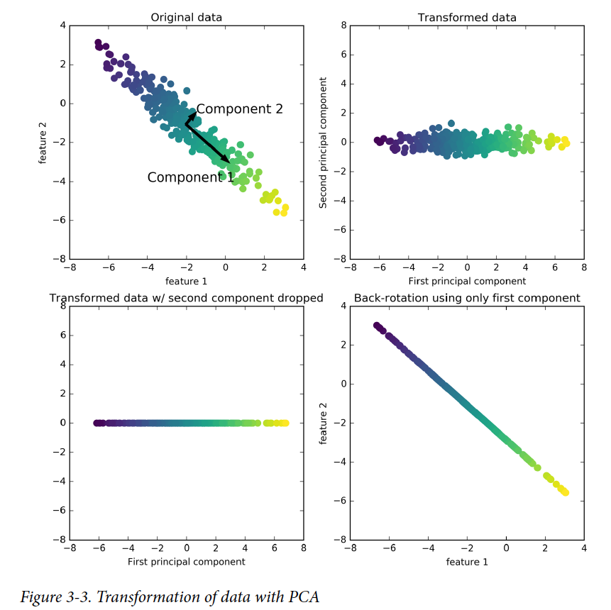
PCA Graphical Explanation
Muller, Introduction to Machine Learning with Python

Slide 50
PCA Intuition – Conceptual (1 of 2)
Scale all variables (Z-scaling)
Define a first axis of highest variance in feature-space of the observations (this is component 1)
Then we iterate until p-axes are selected:
Pick one of the remaining axes which are orthogonal to all previously selected axes …
…such that this selected axis is the one which has the maximum variance among its datapoints, given the previously-selected axes are fixed
When an axis is selected,
it is appended to an ordered
list of components
Slide from Dr. Brett Borghetti, AFIT/ENG CSCE 623 Statistical Machine Learning course, 2019SP

Slide 51
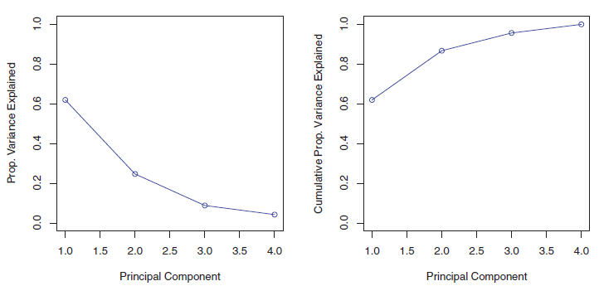
PCA Intuition – Conceptual (2 of 2)
Each successive principal component explains less of the variance in the data
A “scree” plot can be used to visualize the variance explained by the k^{th} component (or cumulative explanation of variance by the k components so far)
Slide from Dr. Brett Borghetti, AFIT/ENG CSCE 623 Statistical Machine Learning course, 2019SP

Slide 52
PCA Interpretation
The projection of the observations into the first k principal components (1..k) represent a lossy approximation of the dataset
In this reduced space, fewer parameters are used to approximate the data
Slide from Dr. Brett Borghetti, AFIT/ENG CSCE 623 Statistical Machine Learning course, 2019SP

Slide 53
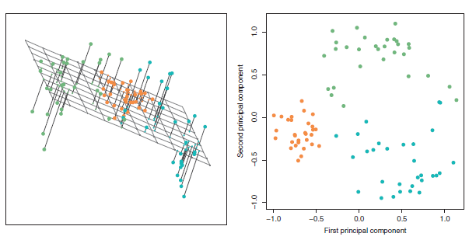
PCA – Uses
Visualize important data relationships (in 2D)
Compression (reduce number of features from p to k)
Mitigate Collinear Features before model fitting
http://www.sthda.com/english/articles/31-principal-component-methods-in-r-practical-guide/112-pca-principal-component-analysis-essentials/

Slide 54
Overview
Big Picture
Clustering
K-means
Hierarchical
Dimension Reduction
Principal Components Analysis (PCA) Process
PCA Evaluation
Anomaly Detection

Slide 55
Anomaly Detection
https://medium.com/learningdatascience/anomaly-detection-techniques-in-python-50f650c75aaf

Slide 56
Anomaly Detection
Definitions:
An outlier is an observation with at least one variable having an unusual value.
A univariate outlier is an observation with a variable that has an unusual value.
A multivariate outlier is an observation with at least two variables having unusual values.
https://medium.com/learningdatascience/anomaly-detection-techniques-in-python-50f650c75aaf

Slide 57
Anomaly Detection Uses
Bank fraud
Medical problems
Monitoring where speed is of the essence
Cyber defense
Process monitoring for structural defect or component failure

Slide 58
Anomaly Detection
Techniques:
Density-Based Spatial Clustering of Applications with Noise (DBSCAN)
Isolation Forests
Local Outlier Factor
Elliptic Envelope
One-Class Support Vector Machines
https://medium.com/learningdatascience/anomaly-detection-techniques-in-python-50f650c75aaf

Slide 59
Anomaly Detection
Density-Based Spatial Clustering of Applications with Noise (DBSCAN)
This is a clustering algorithm (an alternative to K-Means) that clusters points together and identifies any points not belonging to a cluster as outliers.
It’s like K-means, except the number of clusters does not need to be specified in advance.
https://medium.com/learningdatascience/anomaly-detection-techniques-in-python-50f650c75aaf

Slide 60
Anomaly Detection
DBSCAN Method
https://towardsdatascience.com/best-clustering-algorithms-for-anomaly-detection-d5b7412537c8

Slide 61
Anomaly Detection
DBSCAN Method
Use algorithm to assign most points to logical clusters
Randomly select a point not already assigned to a cluster or designated as an outlier.
Determine if it’s a core point by seeing if there are at least min_samples points around it within epsilon distance.
Create a cluster of this core point and all points within epsilon distance of it (all directly reachable points).
Find all points that are near the new cluster, assign a score to datapoint
Repeat for other points
https://medium.com/learningdatascience/anomaly-detection-techniques-in-python-50f650c75aaf

Slide 62
Anomaly Detection
https://scikit-learn.org/stable/auto_examples/miscellaneous/plot_anomaly_comparison.html

Slide 63
Anomaly Detection
Python Demo
https://www.datatechnotes.com/2020/04/anomaly-detection-with-dbscan-in-python.html

